Slide 1


Teaching Your Kids Programming with
Lesson 2

Slide 2
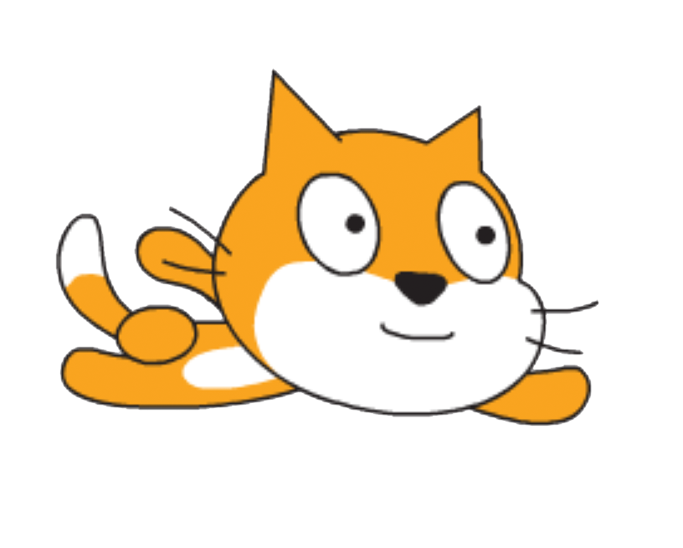
Previously
Motivation
Made fly
Example of completed lesson: https://scratch.mit.edu/projects/275716807/
Coming up
Making a game from the flying

Slide 3
Elements of the game
Ability to move
A point system
Rule for losing points
Rules for ending the game
A way to shoot “lasers”
Rule for gaining points
High score

Slide 4
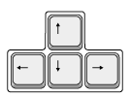
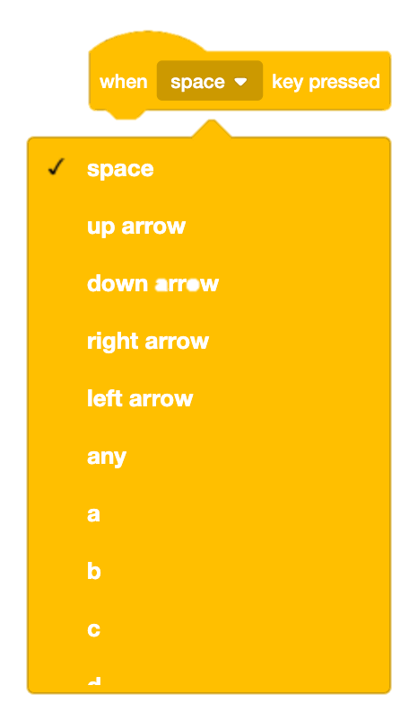
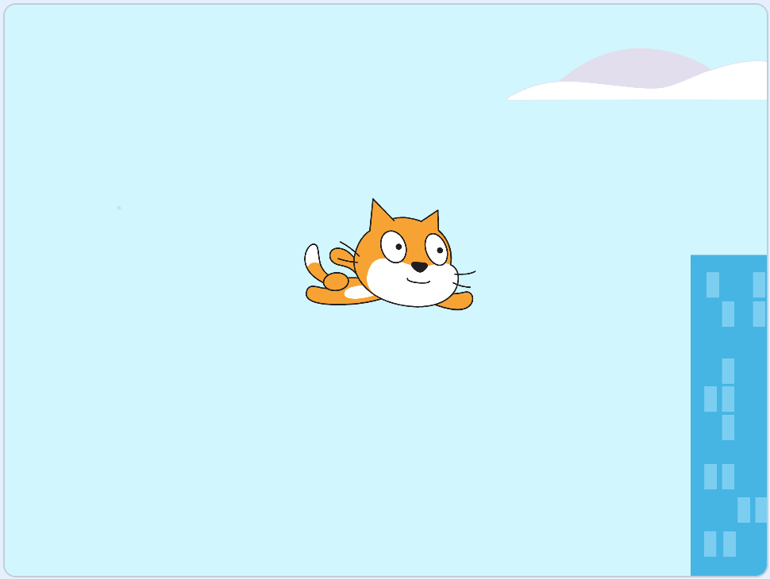
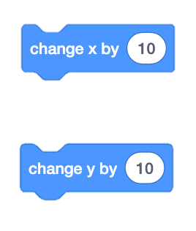
Making the character move
188
y
-212
-255
x
291
! These numbers are different for each character

Slide 5
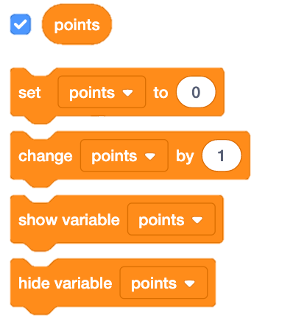
Adding a point system

Slide 6
Decreasing points
if statement which is checked all the time:
Condition that says whether the block inside the “if” block should be executed
Only gets executed when the condition is true

Slide 7
Ending the game
Stop all if points have reached a certain value

Slide 8
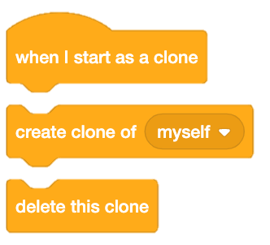
Shooting lasers + cloning
New sprite, Button2
It only runs in the newly created clone, not previous clones.
Clone blocks:
Clones of a sprite will be the same as the original or parent sprite but as a separate instance.
Clones inherit the parent's scripts, costumes, sounds, and properties, yet they can then be modified.

Slide 9

Making the laser move when it’s created
Original button is hidden:
Start showing the clone created when “space” is pressed
Start in the same place as our character, so it looks like the character is shooting
10 steps at a time in the direction of the button sprite

Slide 10
Making points by clearing clouds
In Clouds’ script area:
Replace the existing repeat block with:

Slide 11
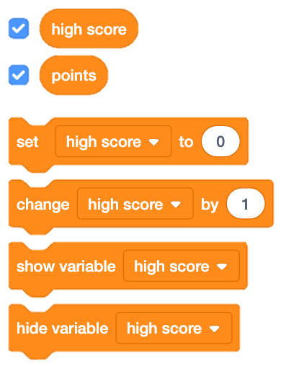
Creating a high score

Slide 12
https://scratch.mit.edu/projects/277348682/

Slide 13
Resources:
Tutorials
Forums
Online examples
Shared projects
Just trying out things

Slide 14
Find more projects to try
https://scratch.mit.edu/explore/projects/all
Categories to choose from:
Animations
Art
Games
Music
Stories

